Slide 1
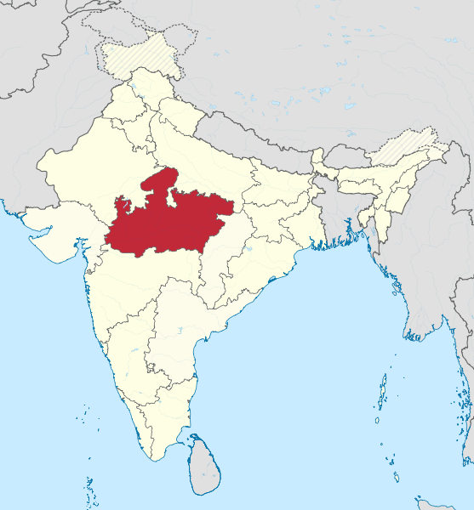
Heart of incredible India
Madhya Pradesh
A state vulnerable and responsive to Climate Change

Slide 2
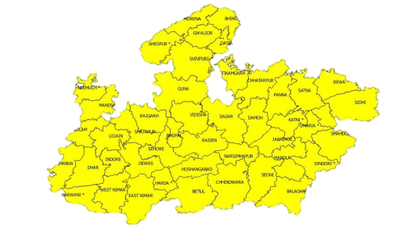
State Profile
Second largest State –
3 lakh Sq KM Approx. 9.38% area
72 Million People,
Decadal Growth rate 21% 6%
Sixth most populous state of country
72% people in Primary Sector
31% Forest Land, 27% Forest Cover (Country’s 12% FSI)
11% Waste Land
11 Unique Agro Climatic zones
49% Area under Cultivation and 35% area under irrigation
33% area classified as over-exploited
40.6 Million livestock population
Annual rainfall varies from 800 mm -1,600 mm
GDP growth rate of the State is 11.08%
Agricultural growth rate of the State is 24%
22,000 villages in the vicinity of forests
10 million people living in these villages.
State with rich flora and fauna having 10 national parks and 27 sanctuaries

Slide 3
E
A
S
Sectoral
Temporal
Impact
Vulnerability
Spatial
Driving Factors
Scope and Scale
Vulnerability of MP

Slide 4
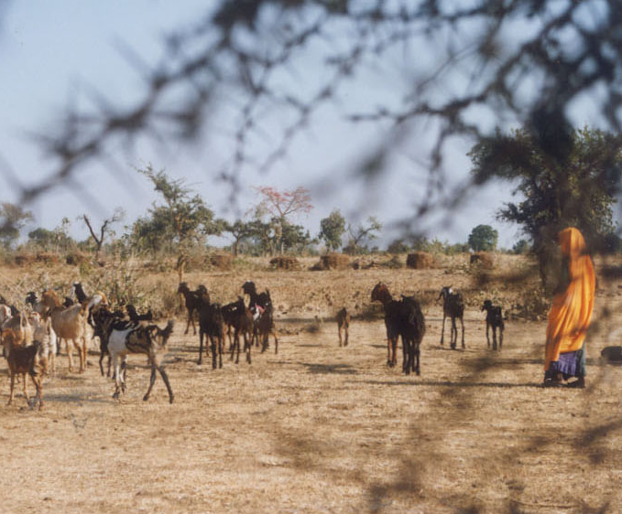
Exposure to Climate Change
Madhya Pradesh is dual exposed
  Biophysical + Socioeconomic and
  Market forces
Extreme Weather events are more frequent and intense
Climate variability is more pronounced and unpredictable than ever before:
  Erratic and uneven rainfall
  Unprecedented rise in Temperatures

Slide 5
Climate Extremes
Frost
Hailstorm
Floods
Heat Waves
Drought
Cold Waves

Slide 6
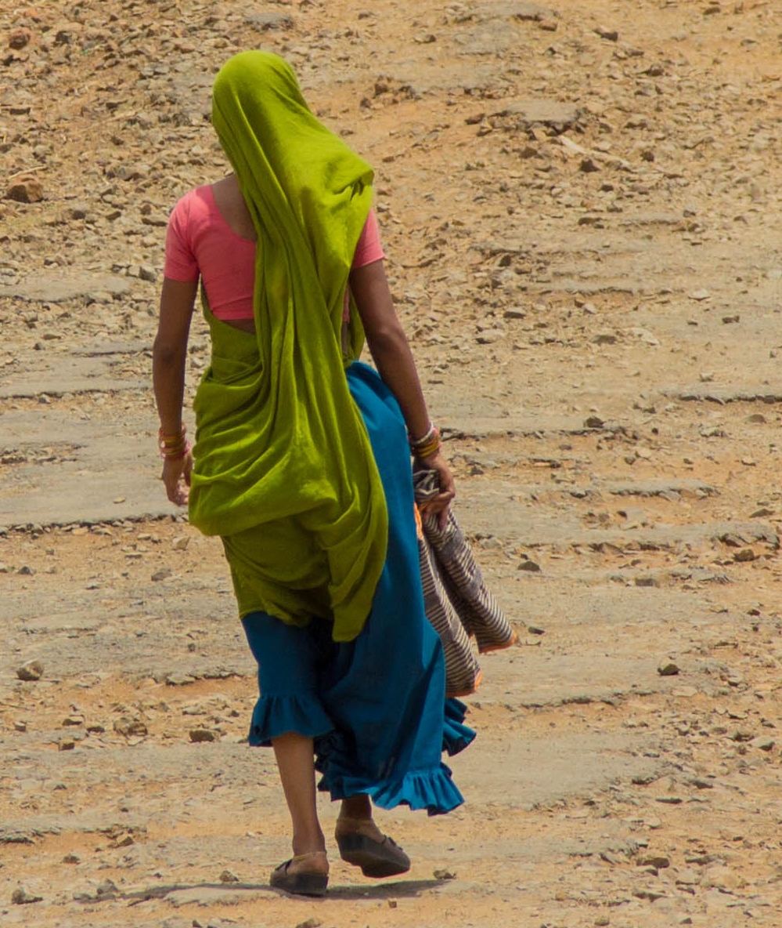
Sensitivity to Climate Change
Vast size- 51 districts, second largest state
Primarily Agrarian economy where agriculture is mainly rain fed
MP striving to achieve development parameters for the population
40% population classified as Below Poverty Line. 35% population tribal
Pockets of acute water scarcity, erratic rainfall bouts of drought and flood prone areas
Other sources of livelihood are based on Natural resources such as NTFP, Fisheries, agro based industries, handicrafts from bamboo

Slide 7
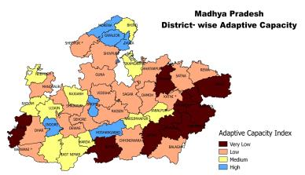
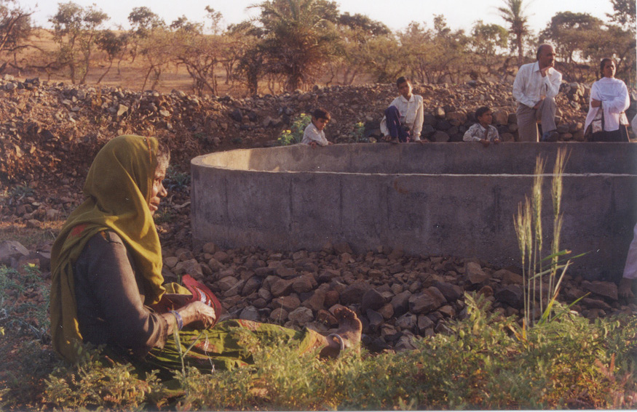
Adaptive Capacity to Climate Change
Low Adaptive capacity
Big development interventions to increase the resilience and coping capacity of rural and urban poor
Opportunities for diversification of livelihood options exist
Dedicated department/ team for climate change issues
Scientific studies being undertaken for more reliable information
SKMCCC, with department leading to formulate adadptation projects

Slide 8
Sectoral Vulnerability
Climate Change
Forests
Agriculture
Water
Human Health

Slide 9
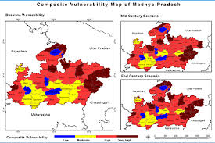
Composite Vulnerability of MP

Slide 10
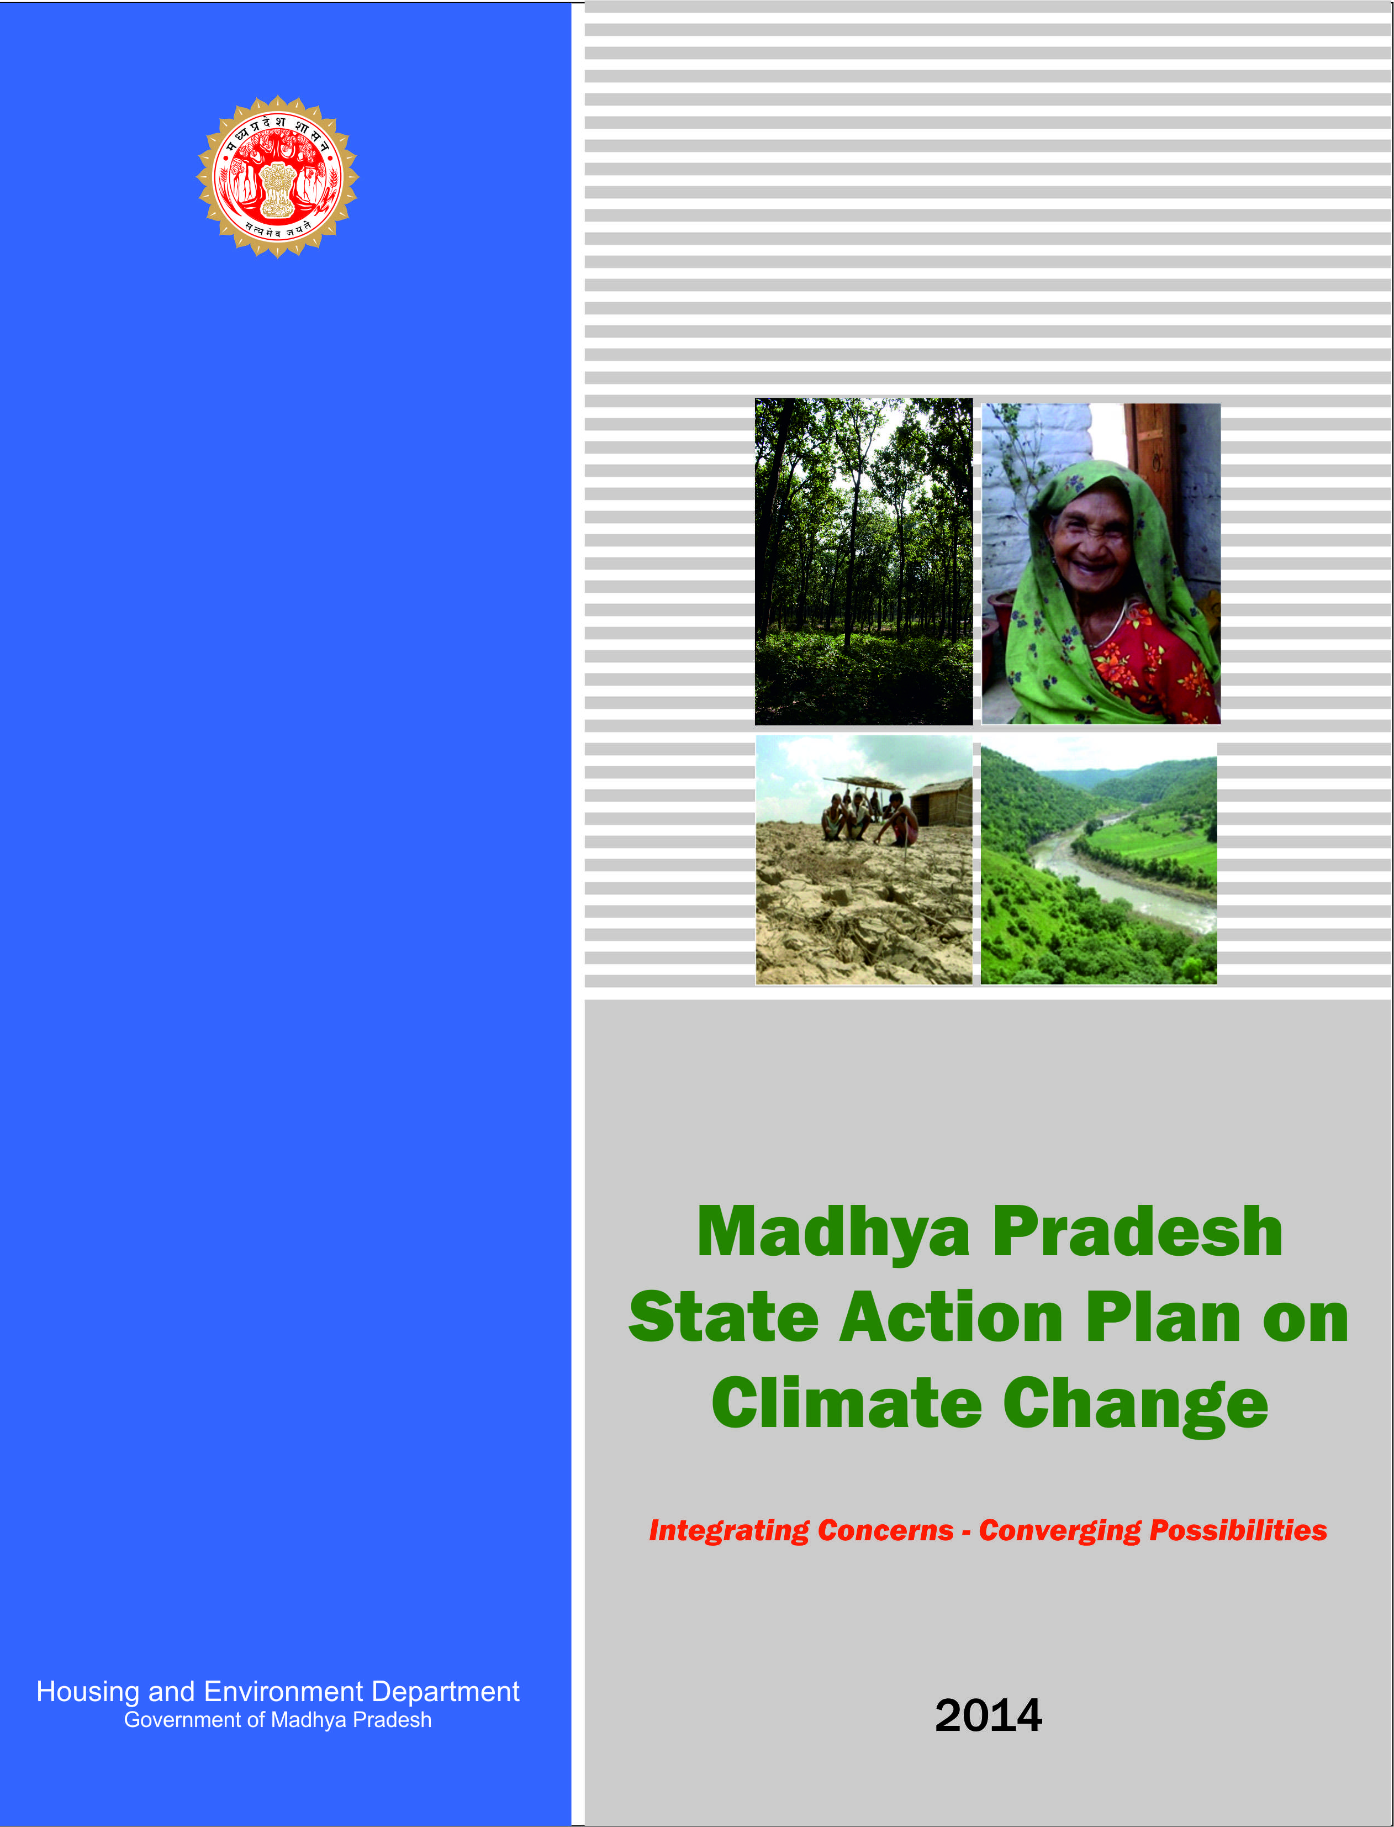
Guiding Principles of MP SAPCC
Focus
Vulnerability and Adaptation (V&A)
Devising appropriate adaptation Aligning with National Missions on Climate Change
Integration of CC Concerns in State programs and policies
Address regional concerns and outline strategies for a climate resilient state
Strengthen developmental planning process favouring low carbon growth

Slide 11
MP SAPCC Process
Endorsement of MPSAPCC by National Steering Committee
ACZ wise consultations
Review by
Experts
Departmental Endorsement
Policy Review
Desk Review of literature
Vulnerability Assessment
Departmental Consultations
Approval of National Expert Committee
Draft SAPCC
Approval by State Steering Committee
Review of NAPCC Mission documents

Slide 12
Strategies bringing positive impact
State Designated Agency for Climate Change
SKMCCC First ever model of climate change at the sub-national level.
Climate Change Knowledge Portal
Participatory and consultative planning process
State studies on VRA and GHG inventory
Helped establish a strong connect between climate science, climate policy and practitioners
Support strategic planning of government agencies
Practitioners
Science
Policy

Slide 13
Initiatives
UNDP-SDC & GoMP Project on Strengthening State Strategies for Climate Actions
Developing 60 Climate Smart Villages in 3 Vulnerable districts of MP under NAFCC
Project on Restoration & Conservation of Traditional Water Supply Sources of Indore under NAFCC
Climate Smart Agricultural & Forest Communities using Landscape Approach in Betul District for GCF
Relocation & Rehabilitation of Forest Dwelling Communities in Tiger Reserves of MP for GCF

Slide 14
New CC Challenges in MP
SDG and Paris Agreement / NDC new Contexts
Data and information for VA
Methodological Clarity and agreements on VA
Drill down VA at the district level
Developing a state specific Resilience plan perhaps revisiting of SAPCC
Formulation of quality adaptation projects to
Implementation of on going projects
Communicating Climate Science and VA results to policy makers and practitioners
Downscaling for up-scalling

Slide 15
Thanks

